Slide 1

Data Imputation - AML Dataset
For Survival Analysis
Ayca Öztürk

Slide 2
Proposed AML Pipeline (first survival, then digital twins)
Missing value analysis
Remove unusable features
Train/Validation/Test split
MICE/data imputation
Exploratory Data analysis (EDA) (relationships, patterns, errors, imbalance, unusual values etc.)
Encode categorical variables (→models need numerical input)
Normalize numerical variables (→numerical features have different ranges→apply scaling)
Feature selection (which variables are included in the model?)
Survival models (from baseline to more advanced)
cox ph model
random survival forest
deepsurv
Model evaluation & Model comparison & Fine-Tuning
Model expainability
Patient digital twin generation
Treatment simulation/Personalized survival prediction

Slide 3
Data Imputation
the process of replacing missing values to obtain a more complete dataset for downstream analysis
mean
median they ignore the relationships between variables and produce bias
zero filling
Alternative: MICE (Multiple Imputation by Chained Equations)
GOAL: not only to fill missing values, but to do so in a logical way for the survival prediction

Slide 4
MICE
uses information from other variables to estimate missing values iteratively.
instead of filling missing values with a single statistic (e.g., mean or median), MICE builds predictive models for each variable with missing data, resulting in more realistic imputations.
Why MICE?
Preserves relationships between variables
more realistic estimates than mean or median imputation
Suitable for datasets containing both numerical and categorical variables
Widely used for clinical and biomedical datasets

Slide 5
Data Preprocessing Pipeline Clinical Patient for survival modeling
Missingness analysis (identifying features with great/est missingness)(which features are missing with what %?)
Eliminating unusable (very high missing) features→reduced dataset !BUT keep clinically important/relevant ones! →ask an expert
Define patient ID, predictors (input variables to predict outcomes, e.g. age,sex,race,wbc,chloroma), and outcomes (results we want to predict, e.g. risk group, os status)
Remove patients with missing survival outcomes
Select variables according to prediction time (baseline: At diagnosis, before treatment response is known, can we predict future survival? So we dont use e.g. mrd% after course 1)
Split patients into: 70% train / 15% validation / 15% test
Fit MICE-like imputer on training data only (only predictors were imputed, outcome variables -e.g. os_days, risk group etc- were not imputed because they are prediction targets and imputing them could introduce target leakage)
For numerical values: MICE (IterativeImputer was used as MICE-like imputer) →Each incomplete numeric feature is modeled using the other numeric features.
For categorical values: the most frequent
Apply the fitted imputer to: validation, and testing sets

Slide 6
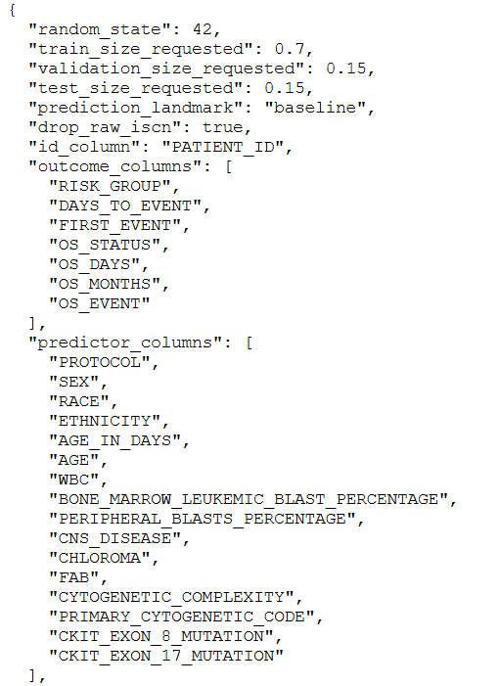
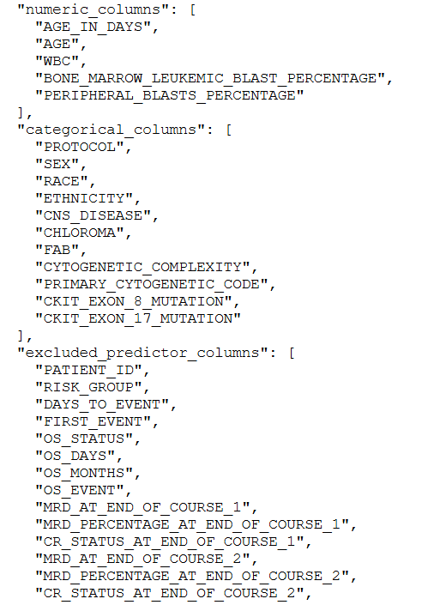
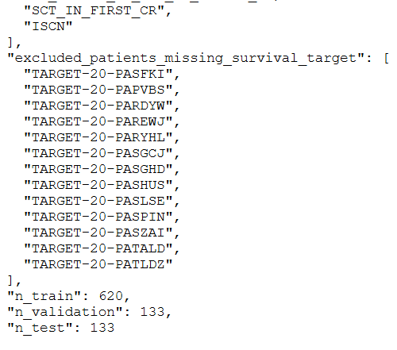
Metadata: outcomes from clinical patient

Slide 7
Data_Clinical_Patient Dataset Overview
Property | Value
Number of patients | 899
Number of variables | 35
Overall missing values | ≈5.5% of all entries

Slide 8
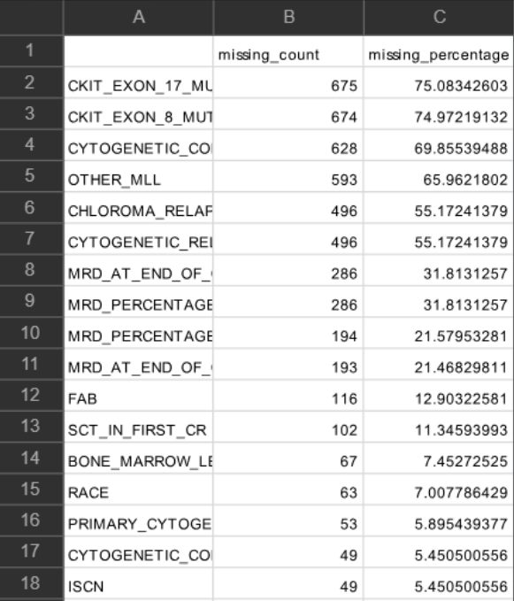
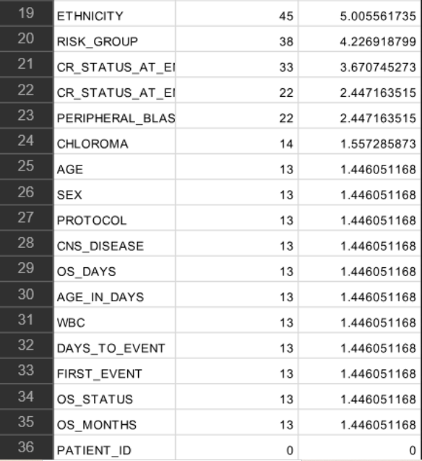
Missingness Summary

Slide 9
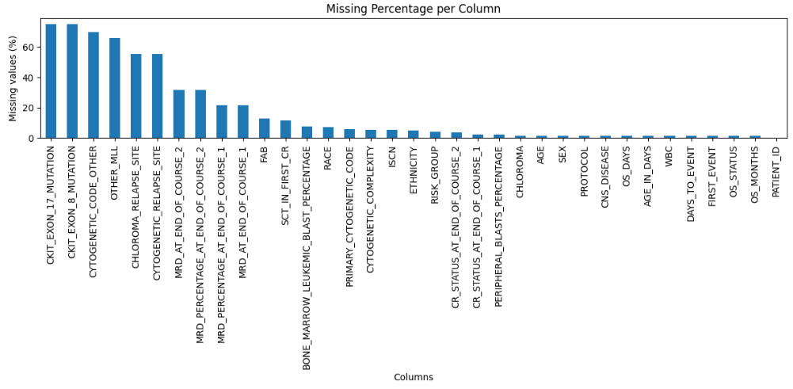
Missing Percentage per Column

Slide 10
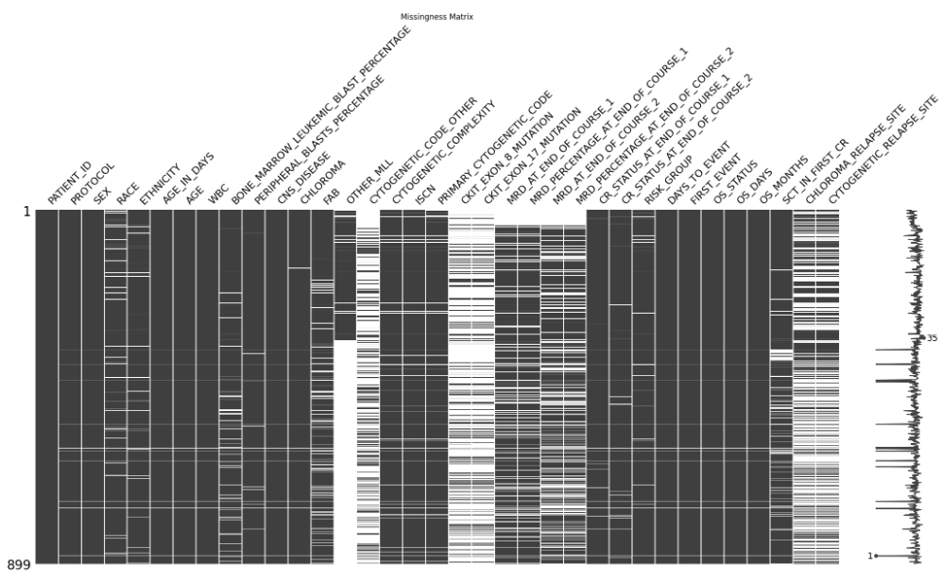
Missingness Matrix

Slide 11
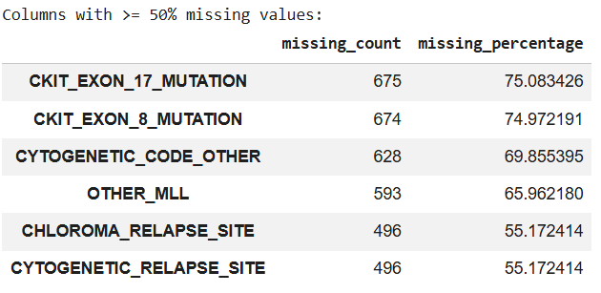
Features with the highest missingness (>=20%!!)
But CKIT_EXON_17_MUTATION and CKIT_EXON_8_MUTATION seem to be important for AML EXCLUDE FIRST THEN SEE HOW IT GOES
→Feature removal should also consider clinical relevance, not only missing percentage.

Slide 12
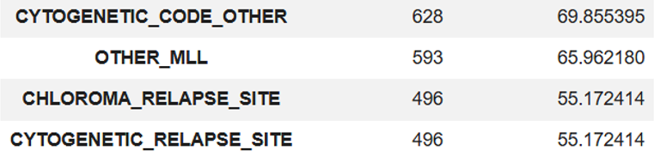
Eliminated (reduced) Features:
Remaining features: 31
The treshold can be altered. 50% was used as a start/example value

Slide 13
Data Preprocessing Pipeline Clinical Sample for survival modeling
Missingness analysis (identifying features with great/est missingness)
Eliminating unusable features→ reduced dataset
Assign samples according to patient-level splits (so that test,train,val sets are consistent for both clinical patient and clinical sample sets to prevent patient-level data leakage)
Create missingness indicators (which features will be imputed?)
For high-missing categorical biomarkers an explicit "Missing" category is created (because keeping them as „Missing“ can be more honest than replacing them with the most frequent, so that it does not lead to incorrect outcomes).
Fit imputers only on training samples
numerical variables with iterative MICE-like imputation;
binary 0/1 variables with most-frequent imputation;
categorical : explicit „missing“ value
Apply fitted imputers to validation and test samples

Slide 14
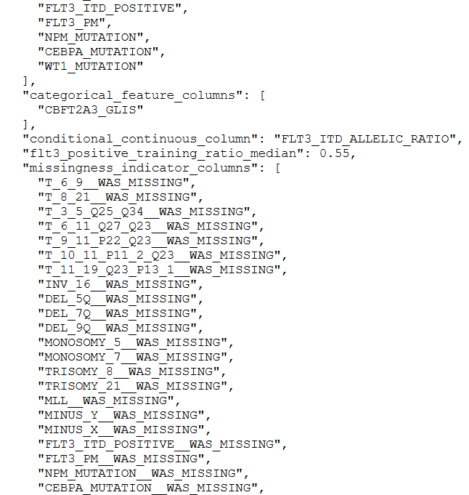
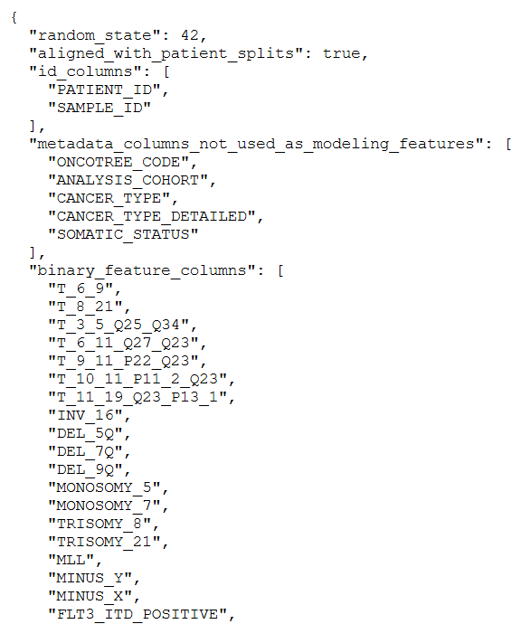
Metadata: outcomes from clinical sample

Slide 15
Data_Clinical_Sample Dataset Overview
Property | Value
Number of patients | 899
Number of samples | 1025
Number of variables | 37
Overall missing values | 17,05%
Some patients have multiple samples:
785 patients → 1 sample
102 patients → 2 samples
12 patients → 3 samples
Samples from same patients go to the same subset (train,test, val)

Slide 16
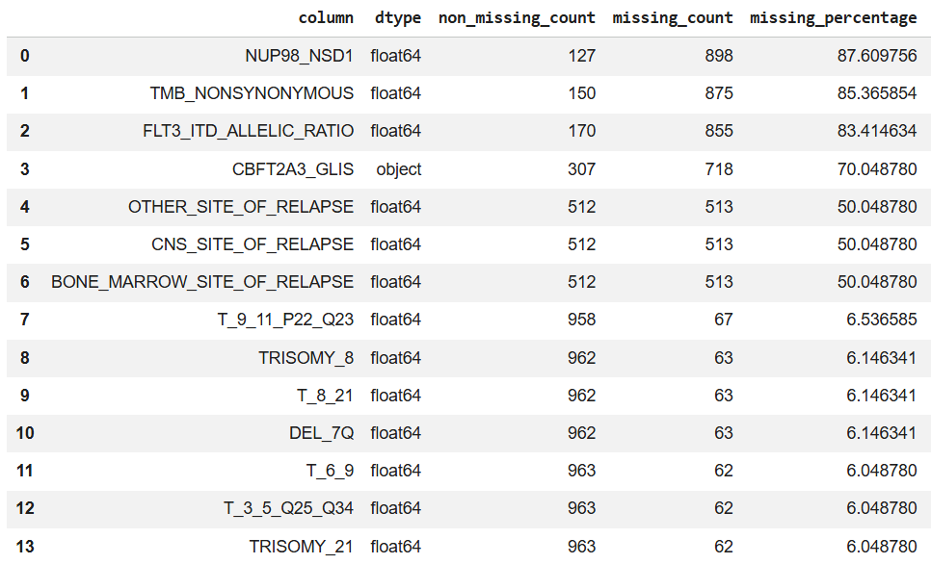
Missingness Summary

Slide 17
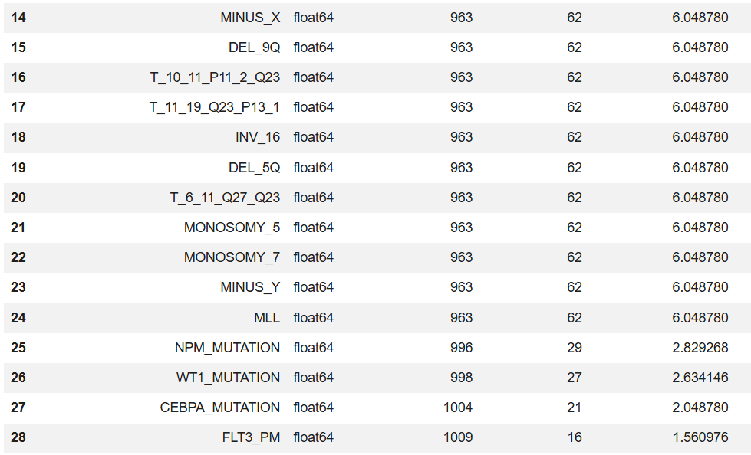
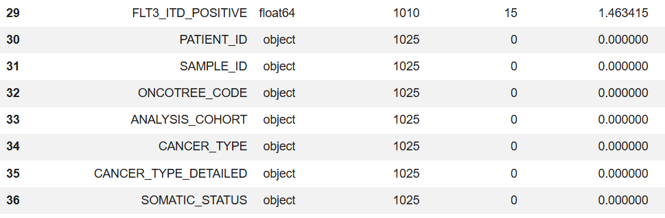

Slide 18
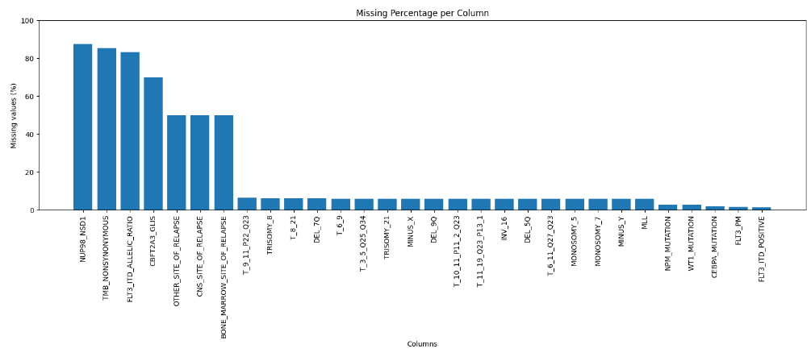
Missing Percentage per Column

Slide 19
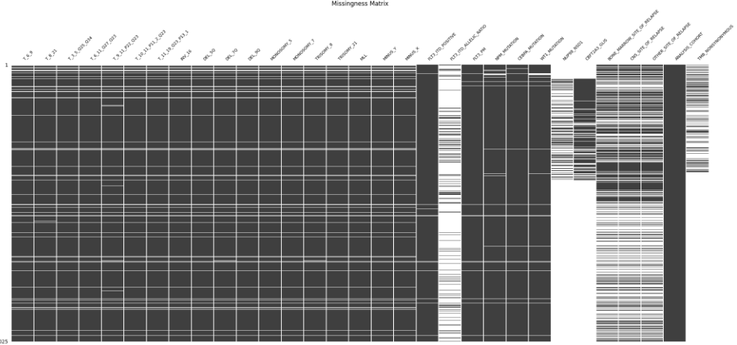
Missingness Matrix

Slide 20
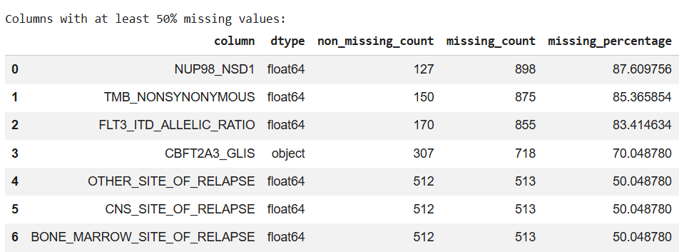
Features with the highest missingness (>=50%)
FLT3 positive?
│
┌────┴─────┐
│ │
Yes No
│ │
Ratio value ----
Eliminated Features:
`NUP98_NSD1`
'TMB_NONSYNONYMOUS'
'OTHER_SITE_OF_RELAPSE'
'CNS_SITE_OF_RELAPSE'
'BONE_MARROW_SITE_OF_RELAPSE'
FLT3_ITD_ALLELIC_RATIO was not eliminated because its value is only present when FLT3_ITD is positive

Slide 21
FLT3_ITD_POSITIVE = 0
→ FLT3_ITD_ALLELIC_RATIO = 0.0
FLT3_ITD_POSITIVE = 1
and ratio observed
→ keep observed ratio
FLT3_ITD_POSITIVE = 1
and ratio missing
→ fill with median ratio from positive training samples

